Slide 1
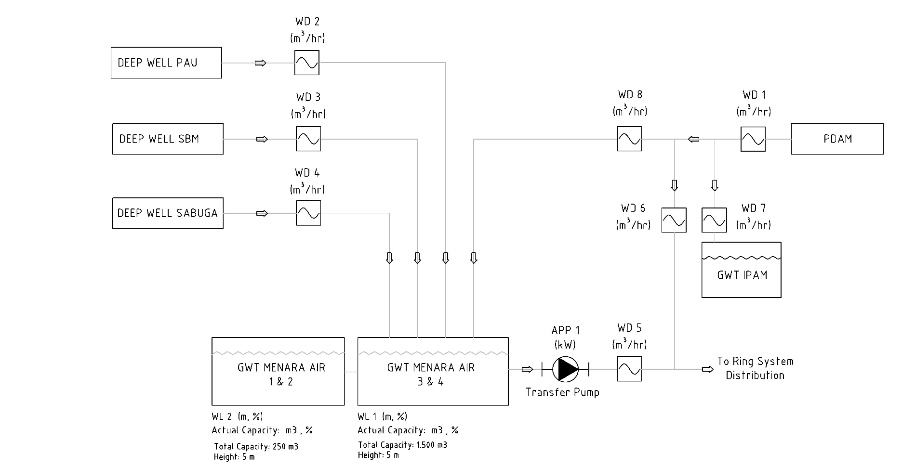
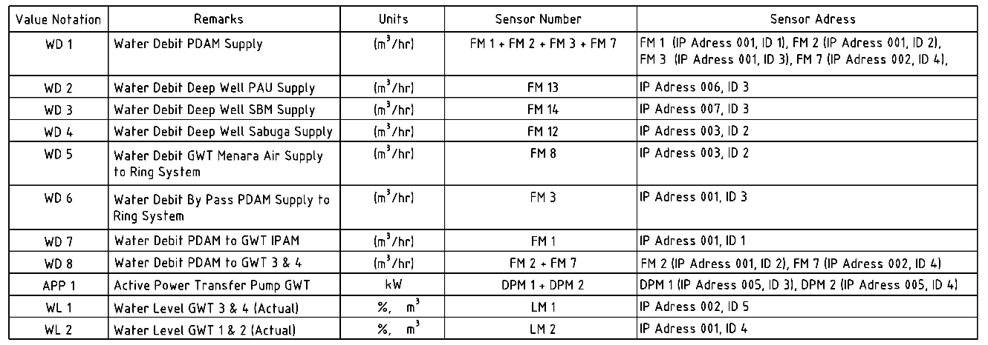
Assignment: Convert Simplified Diagram to HMI Design
EXAMPLE (simplified diagram)

Slide 2



WD 2
EXAMPLE (HMI Design)
13.74 m³/s
Deep Well PAU
WD 3
WD 8
3.74 m³/s
WD 1
13.74 m³/s
PDAM
13.74 m³/s
Deep Well SBM
WD 6
1.96 m³/s
WD 7
1.74 m³/s
WD 4
13.74 m³/s
Deep Well SABUGA
GWT IPAM
APP1
WD 5
13.74 m³/s
3.2 kW
WL2
250m³
98.0%
Ring System Distribution
WL1
1500m³
98.0%
GWT Menara Air 1&2
GWT Menara Air 3&4
Note:
You must use the same icons as in this example.

Slide 3
SI - 02 PAU

Slide 4
SI - 03 SBM

Slide 5
SI - 04 SABUGA

Slide 6
SI - 05 MENARA AIR

Slide 7
SI - 06 CRCS

